Slide 1
Senior Volunteer for Migrant Integration
Fostering social integration in Europe’s diverse societies through volunteering – Samples of good practice
12 September 2019
SVMI Final Conference, Vilnius

Slide 2
What is „volunteering“
“Volunteering is generally considered an altruistic activity where an individual or group provides services for no financial or social gain "to benefit another person, group or organization". (Wilson, John (2000). "Volunteering". Annual Review of Sociology (26): 215, April 2017)

Slide 3
What is „volunteering“
“Estimates show that between 92 and 94 million adults in the EU – i.e. 22 % to 23 % of Europeans aged over 15 – are involved in volunteering, defined as an activity undertaken of a person’s own free will, primarily within a non-governmental organisation for a non-profit cause.” (Source: https://epthinktank.eu/2016/10/20/volunteering-in-the-eu-plenary-podcast/)

Slide 4
What is „volunteering“
“Volunteering is also renowned for skill development and is often intended to promote goodness or to improve human quality of life.”
“Volunteering may have positive benefits for the volunteer as well as for the person or community served.”
“It is also intended to make contacts for possible employment. Many volunteers are specifically trained in the areas they work, such as medicine, education, or emergency rescue.”
(Warburton, Jeni; Oppenheimer, Melanie (2000). Volunteers and Volunteering. The Federation Press.)

Slide 5
History of volunteering
Ancient Roman culture: - voluntare = to wish, to desire - voluntarius = on your own, by your own, by own desire(for free) - res publica = “things” of “public (people)” with a common interest = idea to “serve” a common / community interest = community interest & idea of “the good citizen” = role of citizen as an “active citizen”

Slide 6
History of volunteering
16th / 17th century: The word volunteering has in some countries a still predominantly military meaning, however coinciding with the phrase community service.
19th century: - In America and Central Europe, people became aware of the disadvantaged and realized the cause for movement against slavery. Younger people started helping the needy in their communities. In 1851, the first YMCA in the United States was started. - In Europe and US, the Protestant Church defined “Volunteering” as way to please God (religious connotation to “help the poor”)

Slide 7
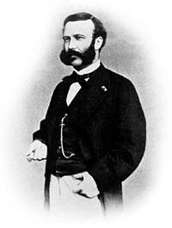
History of volunteering
1859: International Red Cross (Henry Dunant, after Battle of Solferino) - (During the American Civil War, women volunteered their time to sew supplies for the soldiers and the "Angel of the Battlefield" Clara Barton and a team of volunteers began providing aid to servicemen.)
20th century:
In the first few decades of the 20th century, several volunteer organizations were founded, including the Rotary International and Lions Clubs International.
1920ies: Welfare programs & Volunteering

Slide 8
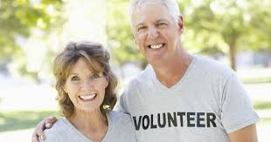
History of volunteering
As of 1945: - Volunteering as „Service learning“ - Institutional volunteering - Skills-based volunteering - International volunteering (reconciliation) - Youth volunteering
European Union Programme for Volunteering - Volunteering and lifelong-learning - Volunteering and development work - Environmental volunteering - Corporate volunteering (global compact) - Volunteering in schools - Community volunteering (neighborhood, sports, care, etc.) - Volunteering for European integration / later for migrant integration (1989 „Youth for Europe“)

Slide 9
Volunteering in Europe today
A Eurobarometer survey published in April 2015, revealed that the most common areas for volunteering are - charity, humanitarian and development aid (44 %); - education, training or sport (40 %), - and culture or art (15 %).
Their activities are usually aimed at a local community (66 %) or the volunteer’s country as a whole (27 %). (Cross-border volunteering remains modest, with only 7 % of activities being aimed at another EU country, and 11 % at other parts of the world.)

Slide 10
Volunteering in Europe today
Volunteering has evolved at a different pace across the EU. While some countries have long-standing volunteering traditions, in others, the voluntary sector is still poorly developed or has yet to emerge. For instance, over a third of young people - in Ireland (42 %), - in Denmark (39 %) and the Netherlands (38 %) have done a volunteering activity - while respondents in Bulgaria (10 %), - in Greece (13 %) and Sweden (15 %) are the least likely to have done so.
Compared to 2011, the largest increases can be seen in Cyprus (+8 %), Italy (+7 %) and Portugal (+6 %).

Slide 11
Volunteering in Europe today

Slide 12
Volunteering in Europe today

Slide 13
Volunteering in Europe today
The big EU programmes are: - The European Voluntary Service (EVS) - EU Aid Volunteers - Youth in Action (2007-2013) - Erasmus+ (2014-2020) - European Year of Volunteering (2011) - EU Parliament Resolution to promote volunteering (2013)

Slide 14
Volunteering in Europe today
Activities of professional associations (activities related to a professional association. Receiving training organised by such association is excluded).
Activities of churches or other religious organisations (activities related to churches, religious communions or associations. Attending holy masses or similar religious acts or helping during these services is also included.)
Activities of recreational groups or organisations (recreational/leisure activities arranged by a club, association or similar. It can be sport groups, hobby associations, or leisure clubs.)
(Source: Eurostat, Agnieszka Litwinska, 2000)

Slide 15
Volunteering in Europe today
Activities of charitable organisations (participation in the unpaid work of charitable organisations groups or clubs, includes unpaid charitable work for churches, religious groups, humanitarian organisations)
Activities of other groups or organisations (activities of environmental organisations, civil right groups, neighbourhood associations, peace groups etc.)
(Source: Eurostat, Agnieszka Litwinska, 2000)

Slide 16
Volunteering in Europe today
activities of charitable organisations (participation in the unpaid work of charitable organisations groups or clubs, includes unpaid charitable work for churches, religious groups, humanitarian organisations)
activities of other groups or organisations (activities of environmental organisations, civil right groups, neighbourhood associations, peace groups etc.)
Attending meetings connected with these activities is always included.

Slide 17
Volunteering in Europe today
activities of charitable organisations (participation in the unpaid work of charitable organisations groups or clubs, includes unpaid charitable work for churches, religious groups, humanitarian organisations)
activities of other groups or organisations (activities of environmental organisations, civil right groups, neighbourhood associations, peace groups etc.)
Attending meetings connected with these activities is always included.

Slide 18
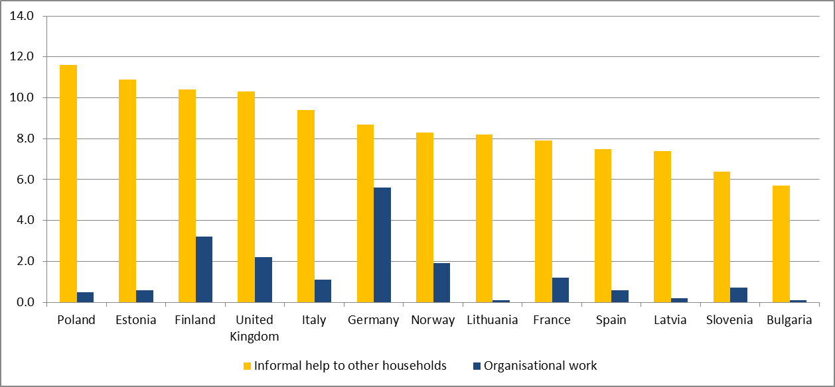
Volunteering in Europe today
(Source: Eurostat, Agnieszka Litwinska, 2000)

Slide 19
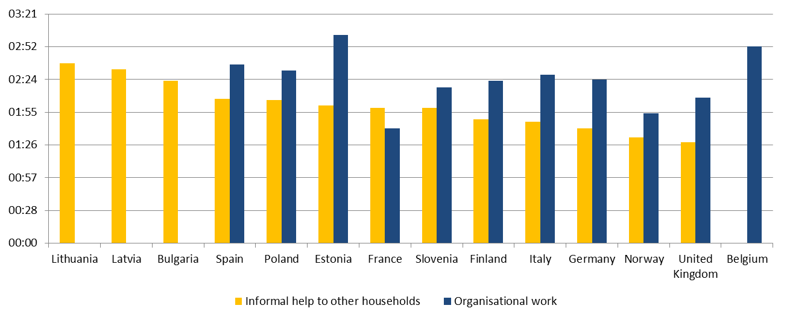
Volunteering in Europe today Time used for volunteering
(Source: Eurostat, Agnieszka Litwinska, 2000)

Slide 20
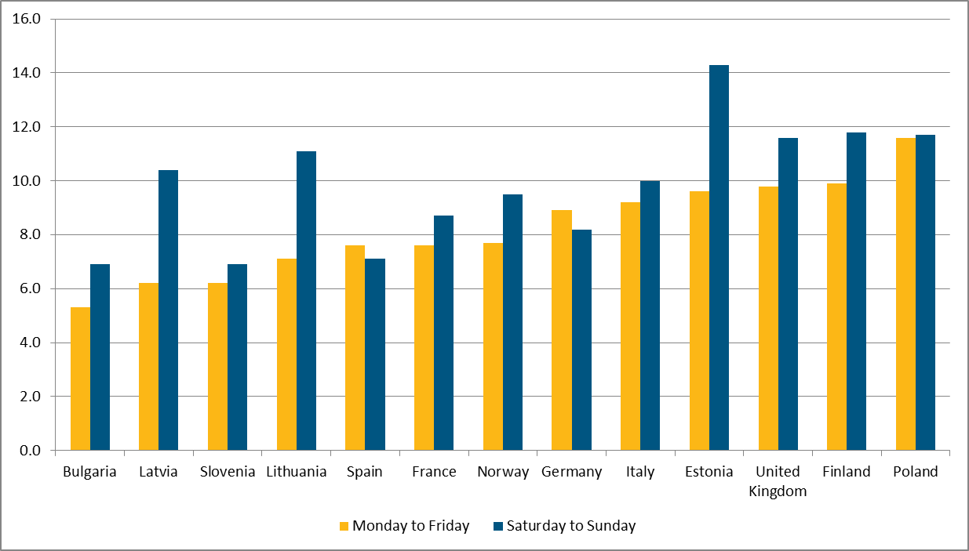
Volunteering in Europe today - a „weekend duty“ ?
(Source: Eurostat, Agnieszka Litwinska, 2000)

Slide 21
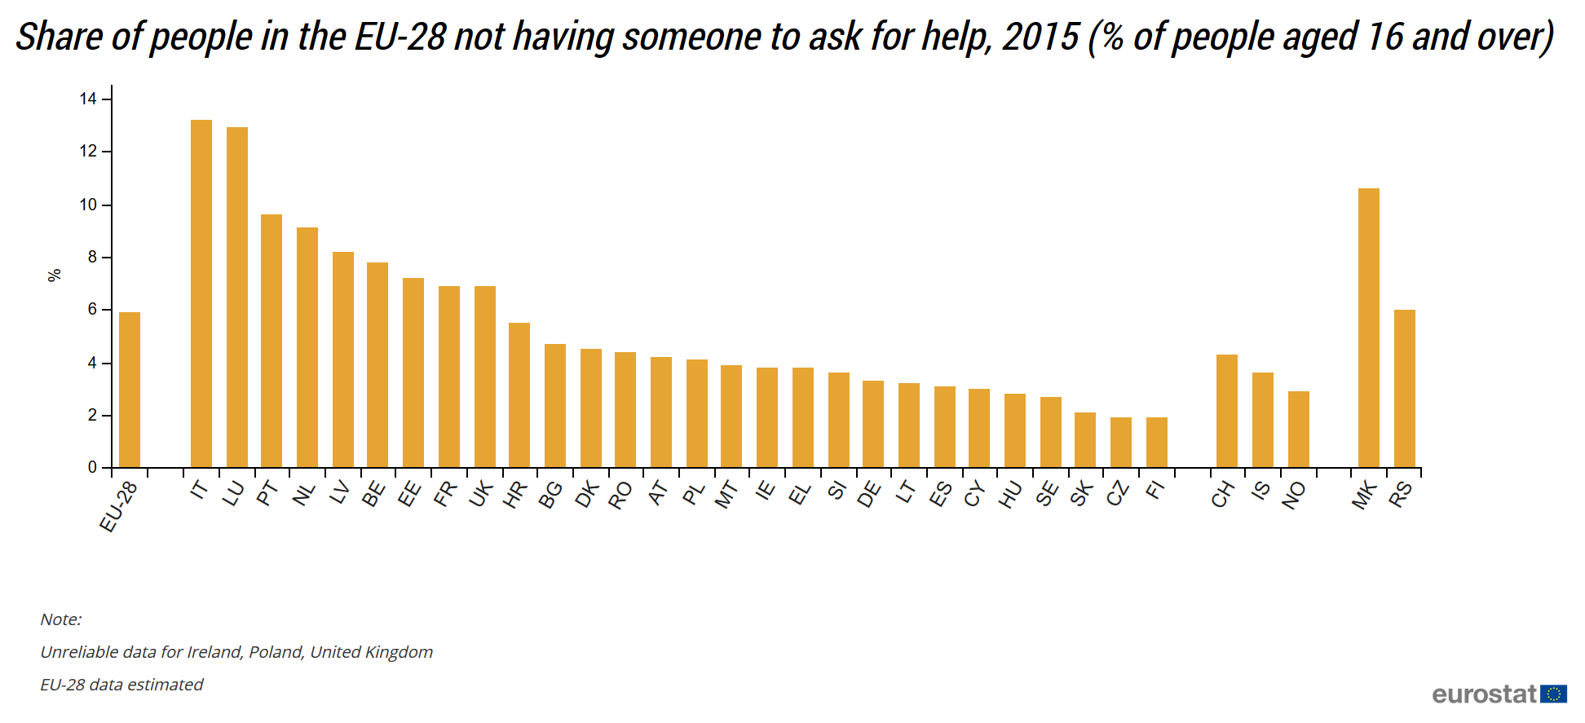
Volunteering in Europe today - not part of everyone‘s culture?

Slide 22
Today‘s idea of volunteering
The role of volunteering & samples of volunteering - volunteering means to devote personal time to the public and social interest - volunteering means learning, giving and interaction - cultural volunteering in diverse society has new role
Volunteering in sports clubs, cultural activities, taking care of seniors, environment and ecology, politics and parties, NGOs, red cross and fire fighters, public movements, migration and integration, social inclusion, people with special needs, etc.

Slide 23
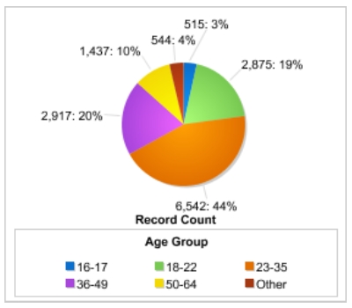
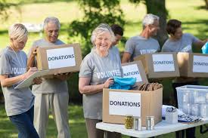
Today‘s idea of volunteering - Age

Slide 24
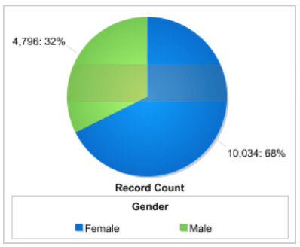
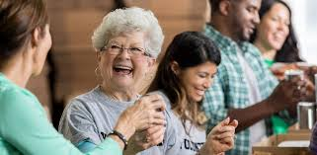
Today‘s idea of volunteering - Gender

Slide 25
Seniors and volunteering
Seniors‘ volunteering still not high on political agenda
Potential of seniors represent high value of experience and knowledge in Europe
Potential of seniors remains unused in Europe
Potential of cross-, inter-generational and inter-ethnic multicutural dialogue by seniors remains unused in Europe
Seniors need to get on political agenda in Europe! („Erasmus for Seniors“!)

Slide 26
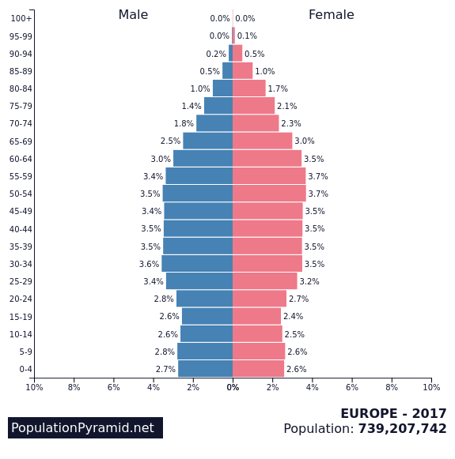
Seniors and volunteering

Slide 27
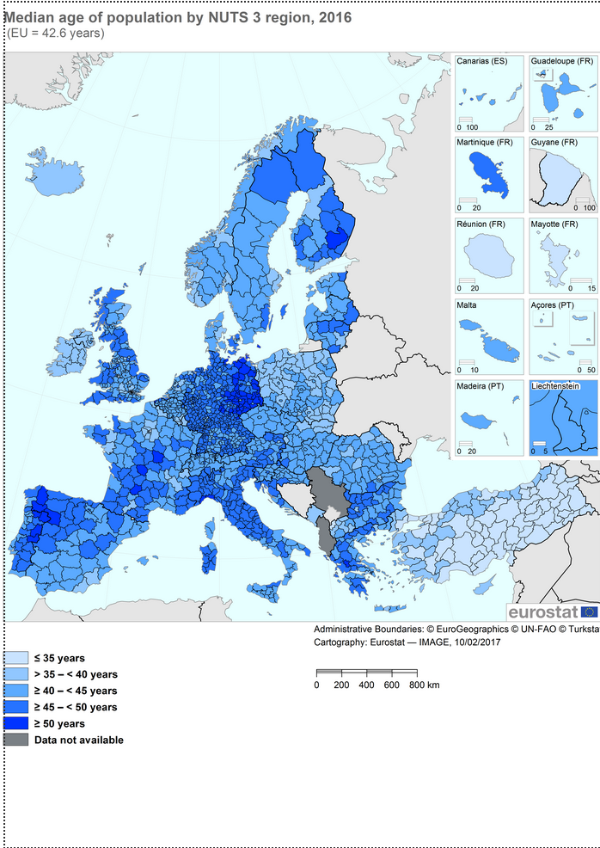
Seniors and volunteering

Slide 28
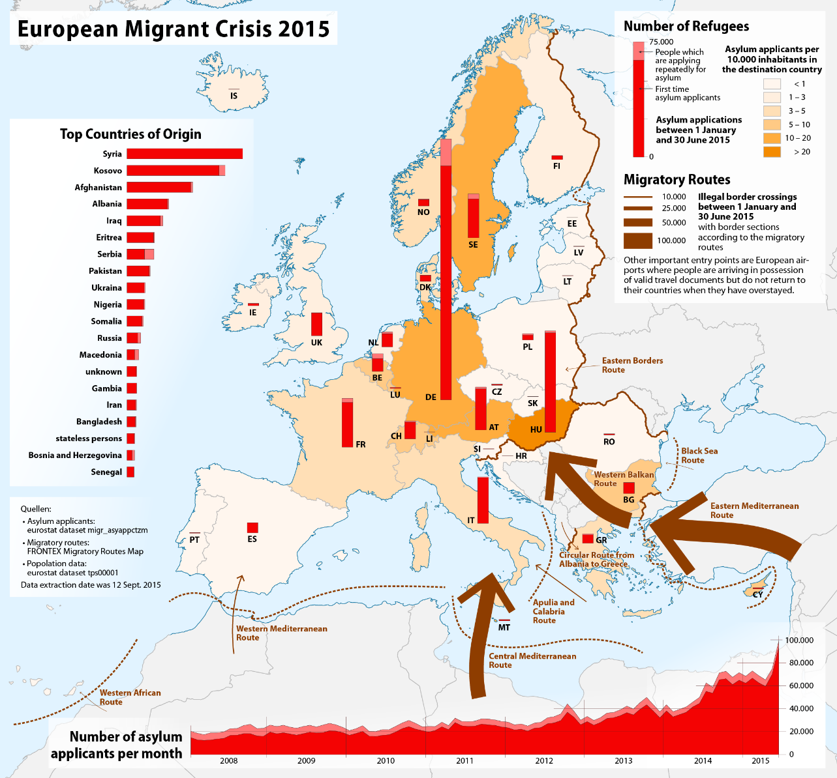
Europe and diversity

Slide 29
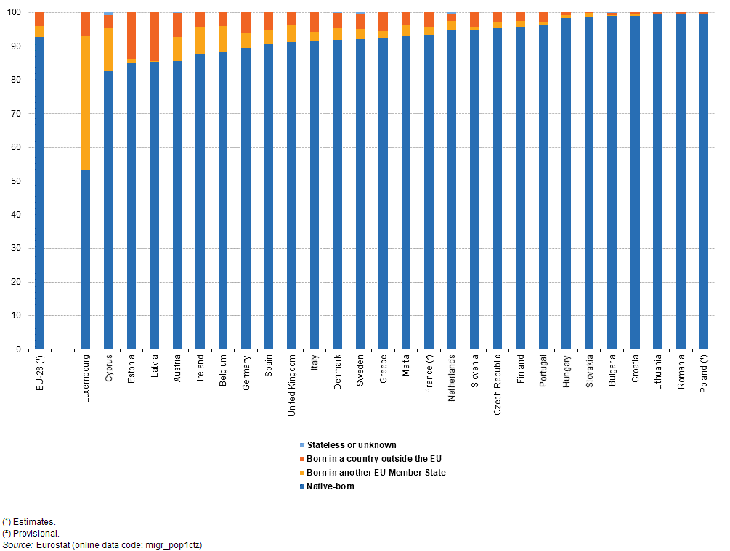
Europe and diversity

Slide 30
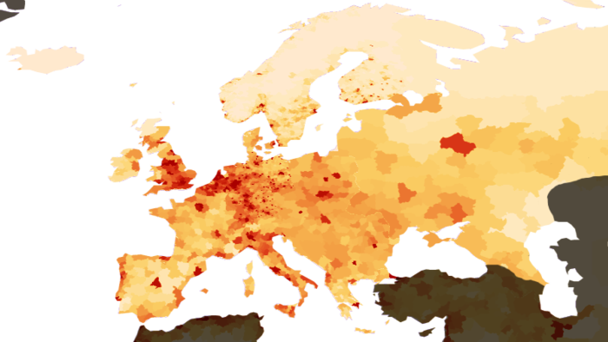
Europe and diversity

Slide 31
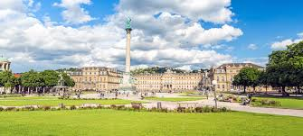
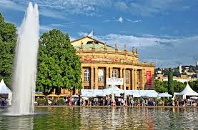
Stuttgart and diversity
Capital of Baden-Württemberg
640.000 inhabitant in City of Stuttgart
2,8 million in metropolitan area
Home of companies like Daimler, Mercedes, Porsche, Bosch, IBM, Hewlett-Packard, Dr. Hauschka, Hugo Boss, Leitz etc.
Appr. 44 – 47% of citizens are migrants
175 nationalities and 47 spoken languages daily
Youth unemployment: below 1,5%
Unemployment: appr. 3,5 %

Slide 32
ifa (Institut für Auslandsbeziehungen) as an example
Founded in 1917 as a sign of peace
center of competence for international cultural relations and artistic discourse
offers extensive opportunities for cultural exchange and civil conflict management
basis : network of national and global partners
Headquarters in Stuttgart, office in Berlin since 1990
About 140 employees
Budget: 25 million €
Funded by the Federal Foreign Office of the Federal Republic of Germany, the state of Baden-Württemberg and its capital Stuttgart
ifa Stuttgart, Photo: Luca Siermann

Slide 33
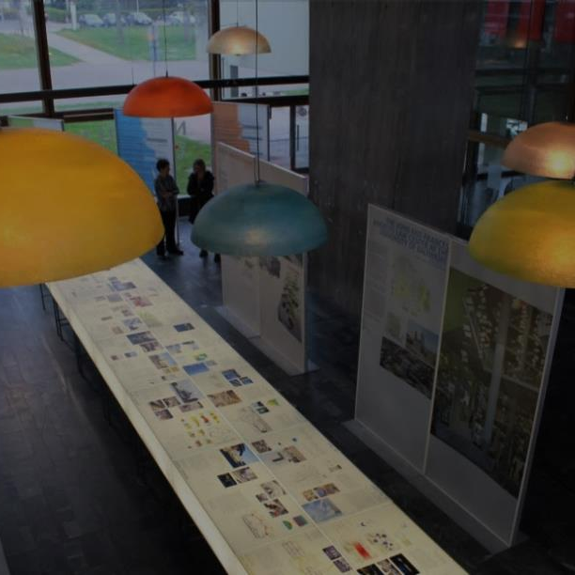
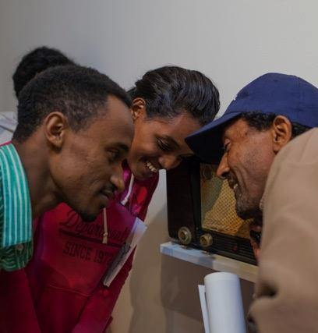
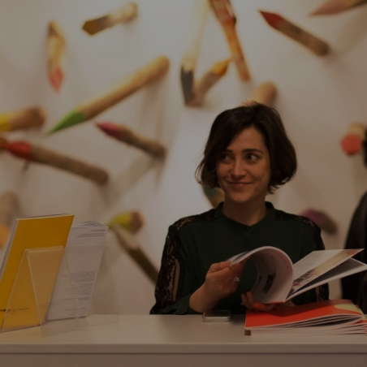
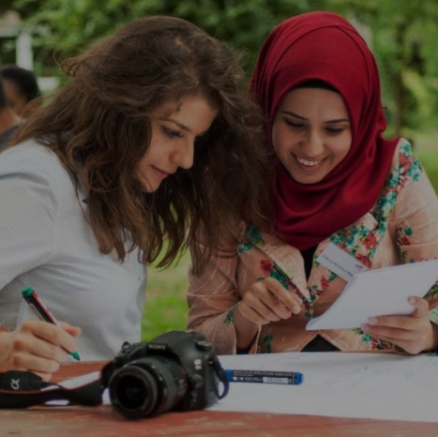
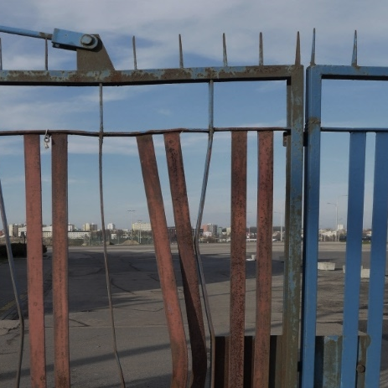
Our topics
Europe
Dialogue of civil societies
Cultural exchange
Research on foreign cultural policy
Culture and Conflict
Migration and Culture

Slide 34
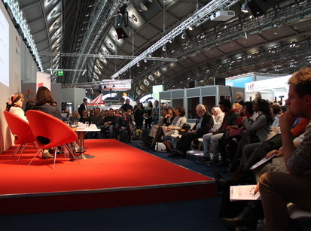
Competence Centre for Culture and Foreign Policy
As a competence centre for culture and foreign policy, ifa is connecting civil societies, cultural practices, art, media and science.
Research Program "Culture and Foreign Policy"
Research assignments and scholarships on topics related to Germany’s Foreign Cultural and Educational Policy
Cooperation with universities, cultural organisations, media and business partners
Events and discussions
Dialogue between civil societies and state
Communication of German culture and policy and exchange with other cultures
Main topics: intercultural dialogue, social human rights, media policy, effective development, civil society and civic education
Panel discussion Views of Europe at Frankfurt Book Fair 2016, Photo: ifa

Slide 35
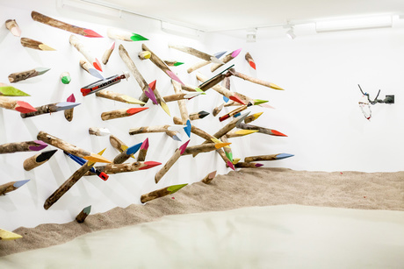
Visual Arts – A Global Language
ifa is one of the leading organisations in the area of international art exchange.
exhibitions of contemporary art, architecture and design at the ifa Galleries in Berlin and Stuttgart
35 exhibitions of contemporary art in international museums
Coordination of the German Pavilion at the Venice Biennale
Untie To Tie. Pascale Tayou: Kolmanskop Dream, Exhibition at ifa Gallery Berlin, March 2017, Photo: ifa
Notes:
Keine Übersetzung von „Tourneeausstellungen“ gefunden für Punkt 2

Slide 36
ifa Akademie
ifa Akademie
German courses (young professionals, migrants, refugees) in combination with social literacy (civic education)
seminars and trainings in the field of culture and education
linked with EUNIC, cooperates with the Academy of the Department for Foreign Affairs
Civic education for migrants, refugees, immigrants
Volunteering services
www.ifa-akademie.de
Students learning German, 2016 Photo: Luca Siermann

Slide 37
Migration and Culture
CCP Refugees and Migration
Work placements for young professionals and volunteers that work in the field of migration
Press review and series
Press Review „Flucht.Migration.Kultur“ (Escape.Migration.Culture)
Weekly Facebook series (Fridays): articles concerning the topic
Burundi Action on Armed Violence 2015, Photo: AoAV

Slide 38
Strengthening intercultural mediators
CrossCulture Programme (CCP)
Work stays for
Young professionals and volunteers
From Germany and Islamic countries
Professional and intercultural experience abroad in the context of their working environment
Participants become multipliers in their home countries
CrossCulture Alumni
Support for alumni projects
facilitation of network-building
Civic education for a “global we”
CrossCulture -Workshop, Stuttgart, November 2016, Photo: Wolfgang Kuhnle/ifa

Slide 39
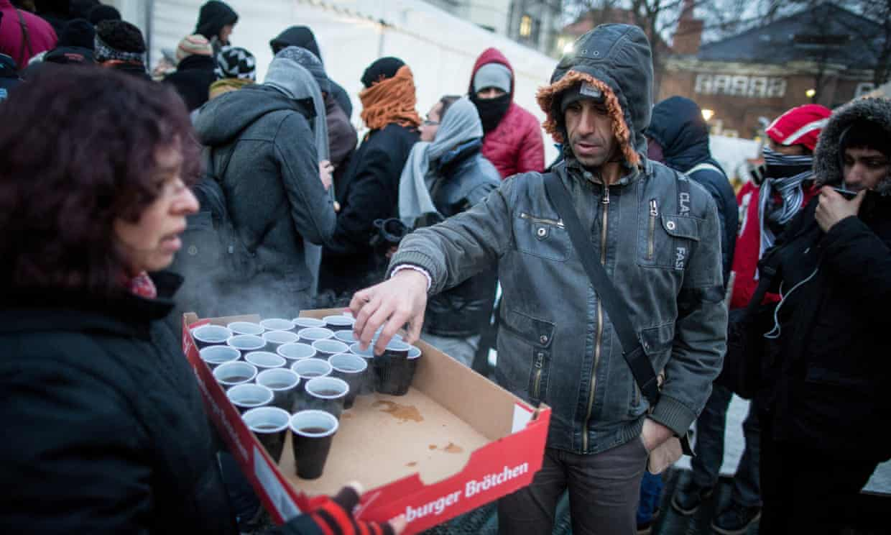
Diversity & Senior Volunteering Samples of good practice
AGDW – Arbeitsgemeinschaft für die eine Welt – Volunteers to assist and accompany refugees, operation of shelters and housing project, sustainable development, mentoring programs
Forum der Kulturen Stutgart – Umbrella organisation of migrants‘ organisations and clubs in Stuttgart with app. 270 member institutions; cultural and social volunteering programs, cultural festival, migration and development, migrant and civic society empowerment
Stadtseniorenrat – City‘s seniors‘ citizens council – companion and meeting programms, local volunteering programs, help for children with homework from school, health and volunteering

Slide 40
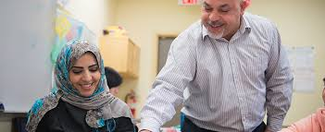
Diversity & Senior Volunteering Samples of good practice
German-Turkish Forum – Migrants‘ association working in German- Turkish context – intergenerational volunteering programs, women‘s integration programs Integrationslotsen – Integration scouts – run by City of Stuttgart – companion programme
„Mama lernt Deutsch“ – „Mum learns German“ – language acquisition program also active in France, Switzerland, Austria, Spain.

Slide 41
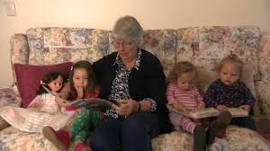
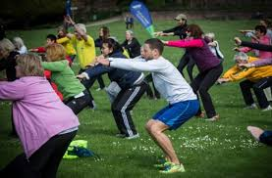
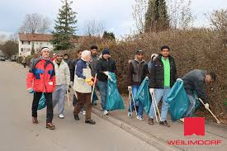
Diversity & Senior Volunteering Samples of good practice
Leseohren – Motivation of young to read
more books, texts – accompanied by
seniors who motivate to read
Sport im Park – Sports in the park, run by
City‘s department for sports, by volunteers
and professional trainers, sports for seniors
and migrants
„Let‘s Putz“ – „City clean up“ to fight the
litter and garbage (volunteers in city
districts)

Slide 42
How to get started…
Check your interests
Look for others
Meet
Develop a local agenda
Network with others locally
Create events
Form a group or institution
Stay informal or be „formal“
Have an input!

Slide 43
Diversity & Senior Volunteering Conclusion
True European potential for seniors needs to be empowered and better used
Senior volunteering needs to get on the political agenda
Senior volunteering for social integration in diverse societies helps to foster social peace, inclusion and democratic progress
Social integration and active citizenship are basics for functional European democracies and stability

Slide 44
Thank you very much for listening!

